Slide 1
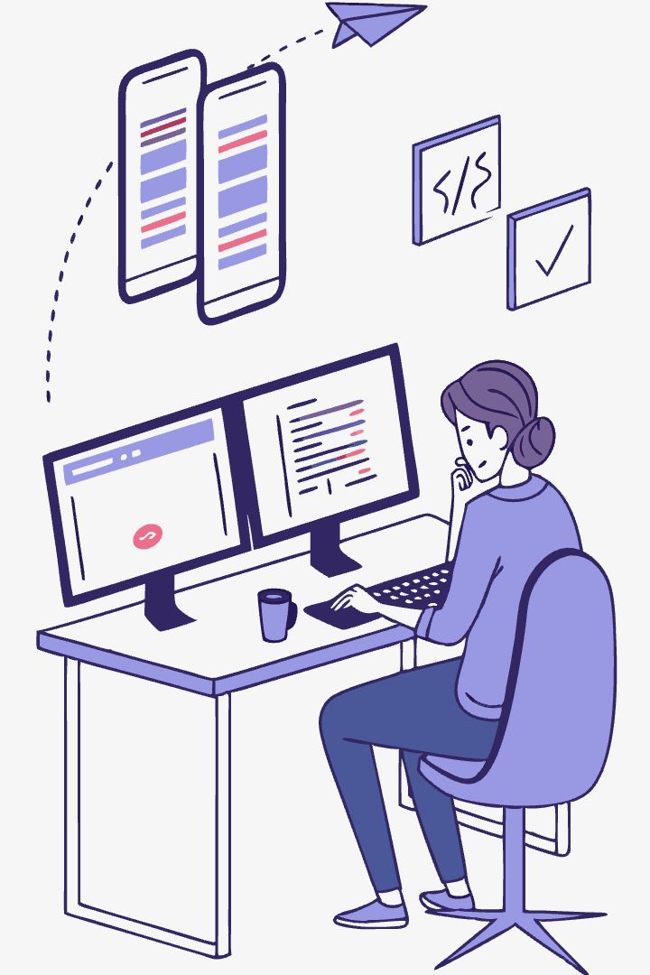

Introduction to React Navigation Components
Navigation is crucial for mobile apps. It shapes how users interact with your application.
React Navigation stands as the #1 navigation library for React Native with over 23 million npm downloads monthly.

Slide 2
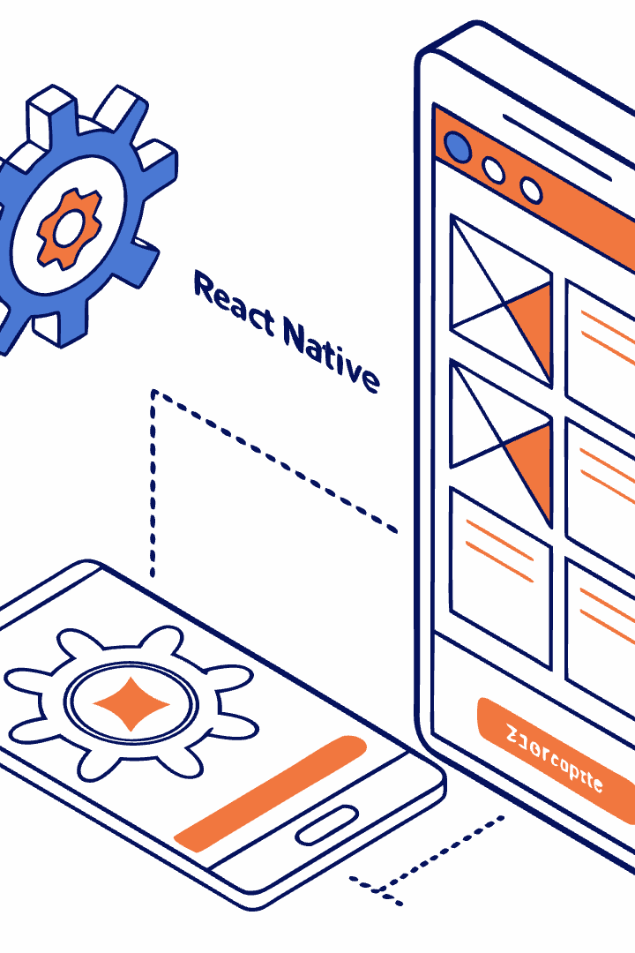



What is React Navigation?
Open-Source
Popular
Versatile
Community-driven library for React Native navigation
24,000+ GitHub stars with 200+ contributors
Supports Stack, Drawer, Tab and custom navigation patterns
Source: github.com/react-navigation/react-navigation

Slide 3
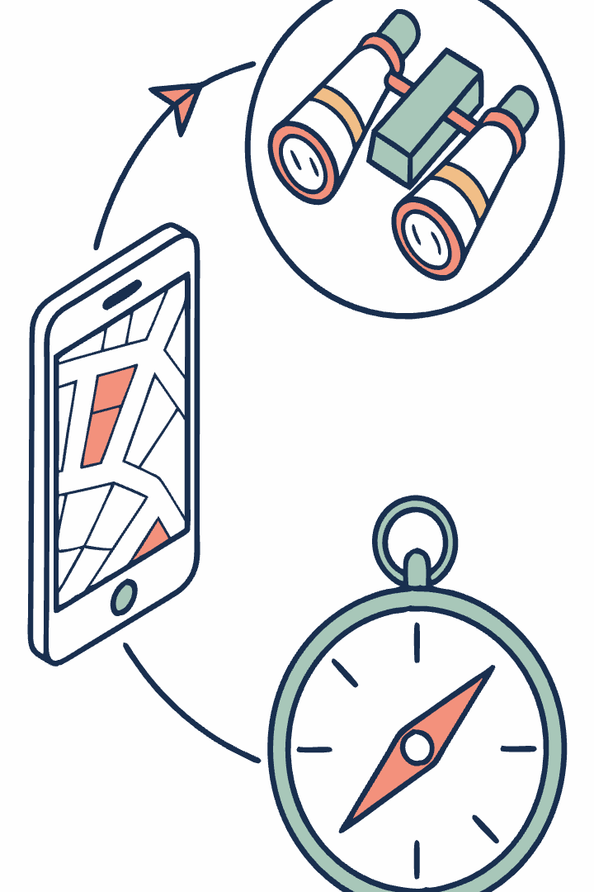
Core Concepts of React Navigation
Navigators
Screens
Components that define navigation structure and style (Stack, Tabs, Drawer)
Components registered with a navigator to define destinations
Navigation Props
Objects passed to screens for navigation control and route information

Slide 4
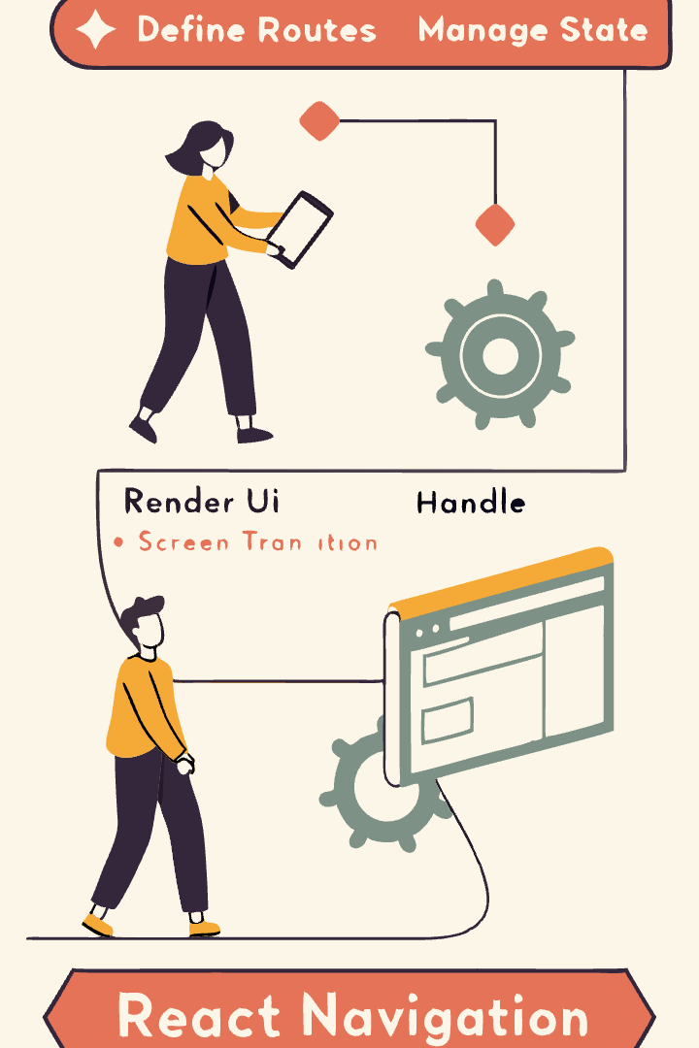
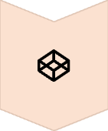

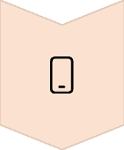
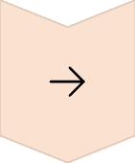
How React Navigation Works
Define Routes
Create navigators and register screens
Manage State
Internal state tracks current screen and history
Render UI
Display appropriate screen based on navigation state
Handle Transitions
Animate between screens based on platform conventions

Slide 5
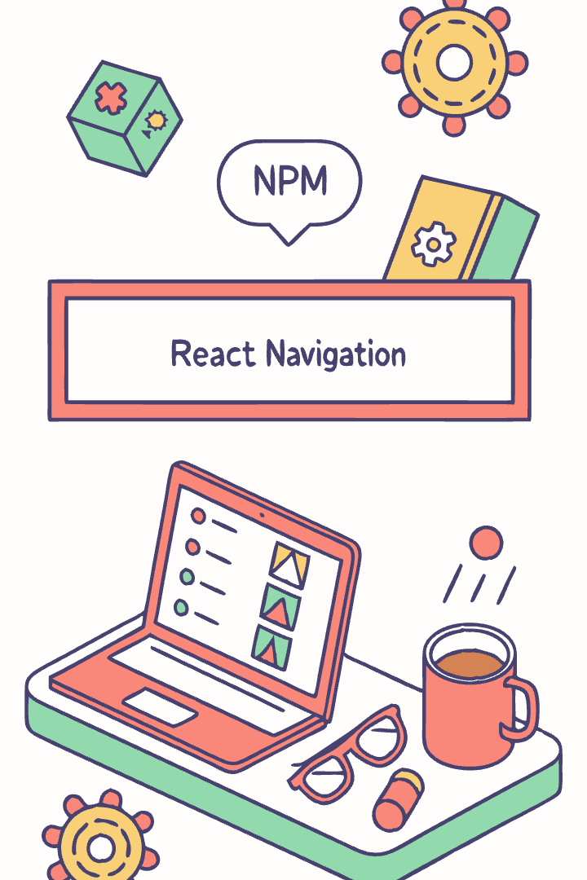
Installation & Setup
Install Core Package
npm install @react-navigation/native
Install Dependencies
npm install react-native-screens react-native-safe-area-context
Install Navigator Types
npm install @react-navigation/stack @react-navigation/drawer @react-navigation/bottom-tabs
Requires React Native 0.63+ for full compatibility. Works with both Expo and bare React Native projects.

Slide 6
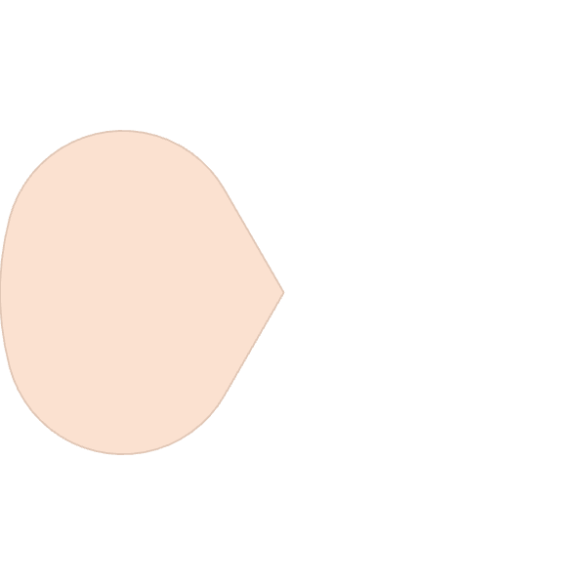





Overview: Types of Navigation
Drawer Navigation
For app-wide menus that slide in from the side
Stack Navigation
For sequential flows and history tracking
Tab Navigation
For switching between main app sections

Slide 7
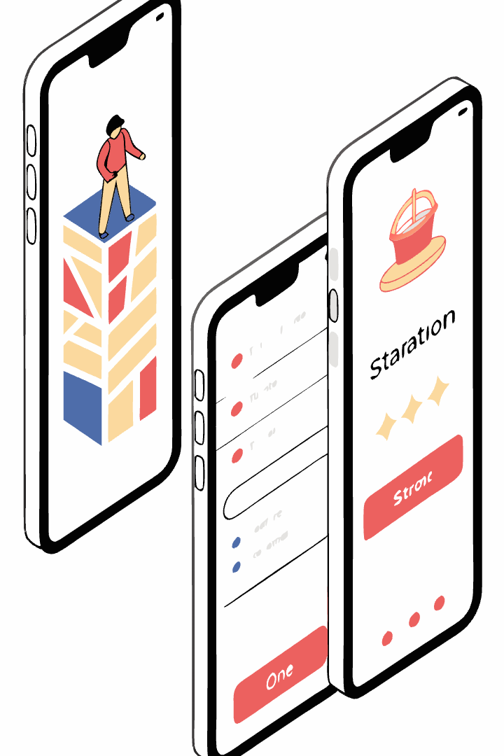
When to Use Each Navigator
Navigator Type
Best For
Example Use Cases
Stack
Detail flows
Product list → details → checkout
Drawer
Global access
Settings, user profile, help center
Tab
Main sections
Home, search, notifications, profile

Slide 8
Stack Navigation: Introduction
What It Is
Key Characteristics
Stack navigation is like a stack of cards. New screens slide in from the side and can be popped off to go back.
Back button appears automatically
Swipe-back gesture on iOS
It mimics the native behavior of iOS and Android navigation patterns.
Header with title and navigation controls
Natural for detail views and forms

Slide 9
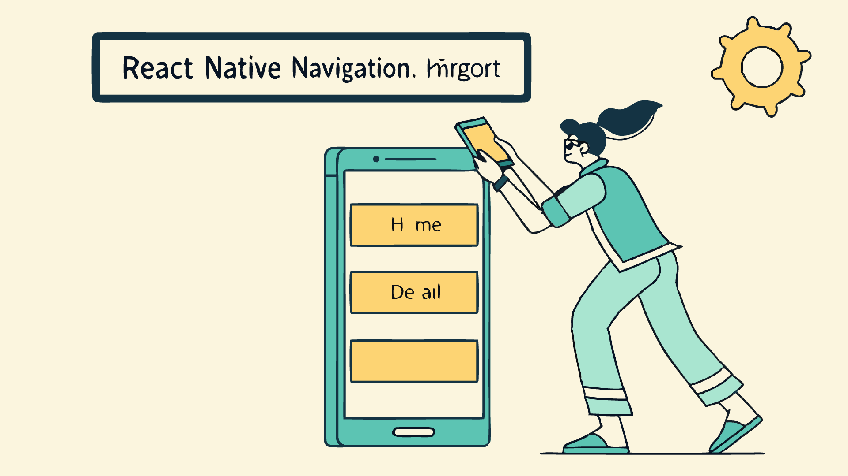
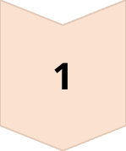
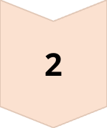
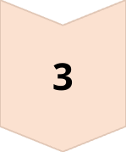
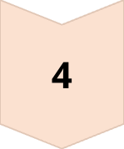
Implementing Stack Navigation
Import the Navigator
Import { createNativeStackNavigator } from '@react-navigation/native-stack';
Create Stack Navigator
const Stack = createNativeStackNavigator();
Define Navigation Structure
Return Stack.Navigator with Stack.Screen components for each route
Wrap with NavigationContainer
Place Stack.Navigator inside NavigationContainer at app's root

Slide 10
Stack Navigation: Sample Code
Basic Setup and Imports
// App.js
import React from 'react';
import { NavigationContainer } from '@react-navigation/native';
import { createStackNavigator } from '@react-navigation/stack';
import { Button, Text, View, StyleSheet } from 'react-native';
const Stack = createStackNavigator();
Home Screen Component
Details Screen Component
// Home Screen
function HomeScreen({ navigation }) {
return (
<View style={styles.screen}>
<Text style={styles.text}>Home Screen</Text>
<Button
title="Go to Details"
onPress={() => navigation.navigate('Details')}
/>
</View>
);
}
// Details Screen
function DetailsScreen({ navigation }) {
return (
<View style={styles.screen}>
<Text style={styles.text}>Details Screen</Text>
<Button
title="Go back"
onPress={() => navigation.goBack()}
/>
</View>
);
}

Slide 11
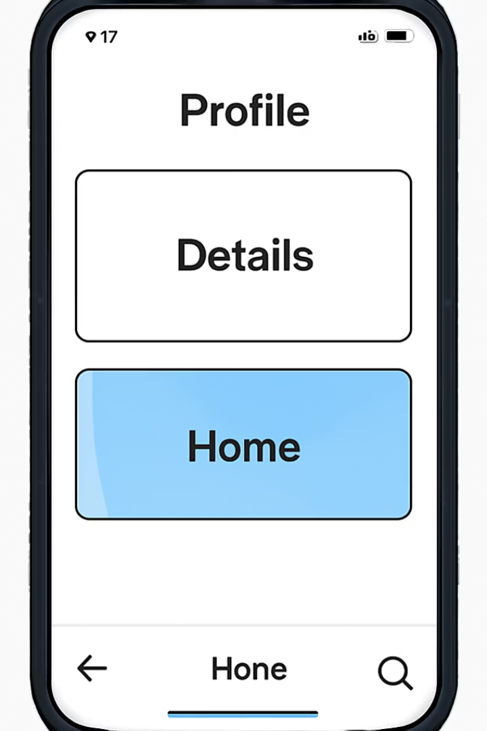
Stack Navigation: Sample Code(continue)
Navigator Configuration
// App Component
export default function App() {
return (
<NavigationContainer>
<Stack.Navigator>
<Stack.Screen name="Home" component={HomeScreen} />
<Stack.Screen name="Details" component={DetailsScreen} />
</Stack.Navigator>
</NavigationContainer>
);
}
Component Styling
const styles = StyleSheet.create({
screen: {
flex: 1,
alignItems: 'center',
justifyContent: 'center',
},
text: {
fontSize: 20,
marginBottom: 20,
}
});

Slide 12





Stack Navigator: Key Features
Screen Management
Header Customization
Push new screens onto the stack with navigation.push(). Pop screens with navigation.goBack() or navigation.pop().
Control header appearance with options prop. Add buttons, change colors, or hide completely.
Parameter Passing
Transition Effects
Send data between screens with navigation.navigate('Screen', { paramName: value }). Access with route.params.
Customize animations with cardStyleInterpolator and headerStyleInterpolator options.

Slide 13
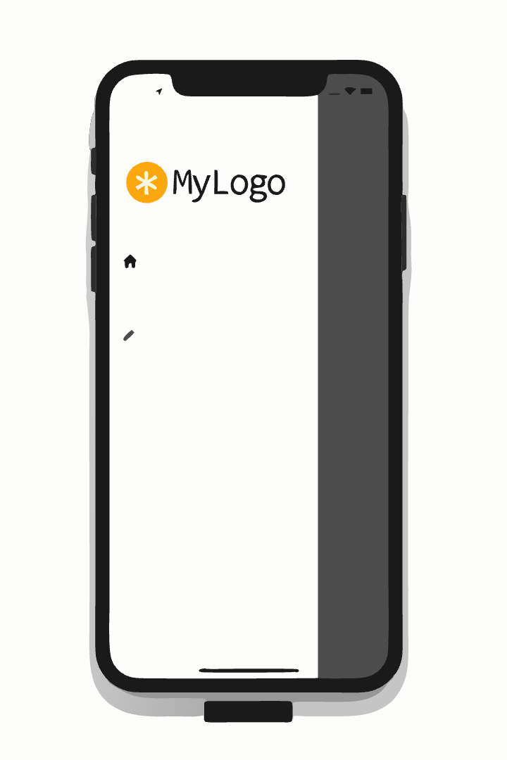
Drawer Navigation: Overview
Slide-in Menu
When to Use
The drawer slides in from the edge of the screen. Users can open it via tap or swipe gesture.
Global app features
Supplementary navigation
Settings or profile access
Less frequently used sections
Perfect for features that shouldn't clutter the main interface but need to be accessible from anywhere.

Slide 14
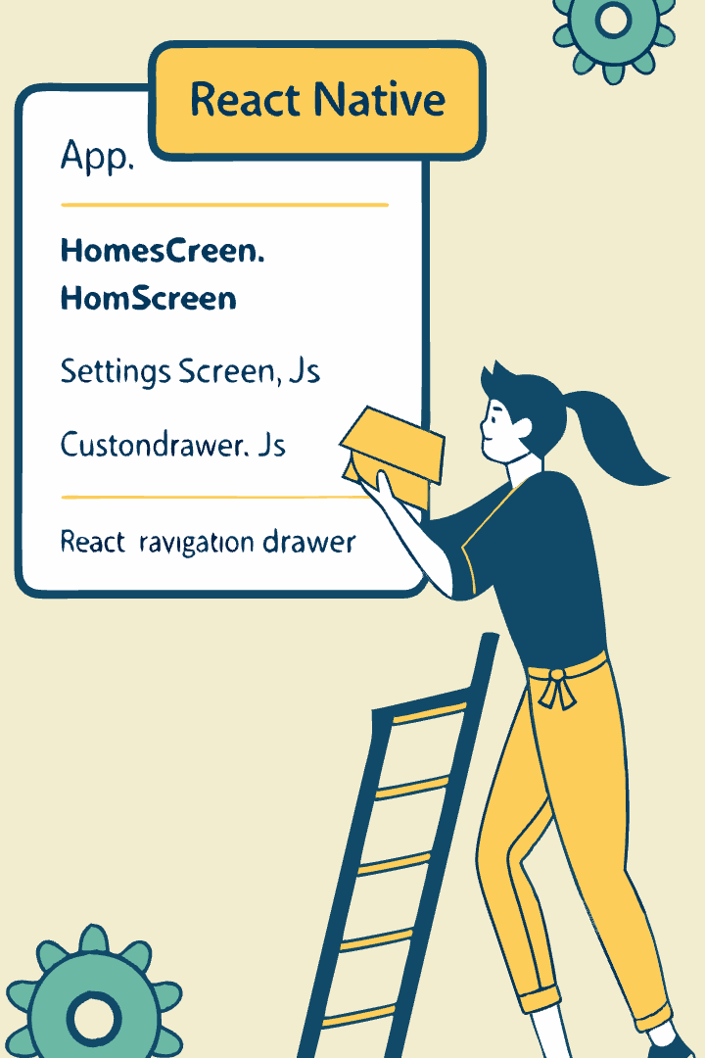
Setting Up Drawer Navigation
Import Package
Import { createDrawerNavigator } from '@react-navigation/drawer';
Create Navigator
const Drawer = createDrawerNavigator();
Define Drawer Routes
Set up Drawer.Navigator with Drawer.Screen components
Customize (Optional)
Add drawerContent prop for custom drawer design

Slide 15
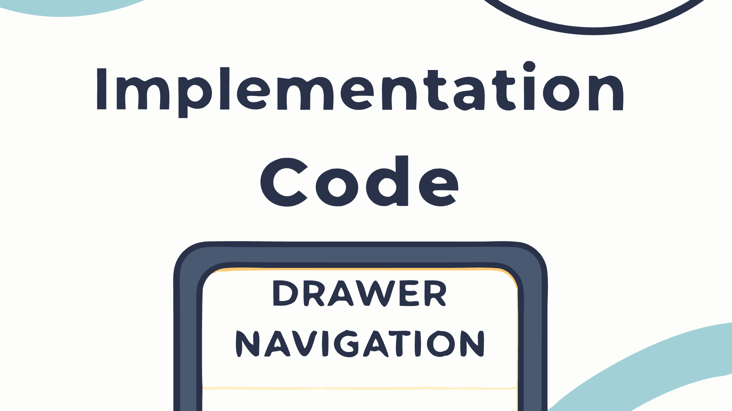
Drawer Navigation: Sample Code
1. Setup and Imports
import React from 'react';
import { NavigationContainer } from '@react-navigation/native';
import { createDrawerNavigator } from '@react-navigation/drawer';
import { Button, Text, View, StyleSheet } from 'react-native';
// Create the drawer navigator
const Drawer = createDrawerNavigator();
2. Screen Components
function HomeScreen({ navigation }) {
return (
<View style={styles.screen}>
<Text style={styles.title}>Home Screen</Text>
<Text style={styles.text}>Welcome to the main screen!</Text>
<Button
title="Open Drawer"
onPress={() => navigation.openDrawer()}
/>
</View>
);
}
function ProfileScreen({ navigation }) { return ( <View style={styles.screen}> <Text style={styles.title}>Profile Screen</Text> <Text style={styles.text}>This is your user profile</Text> <Button title="Open Drawer" onPress={() => navigation.openDrawer()} /> </View> ); }
function SettingsScreen({ navigation }) {
return (
<View style={styles.screen}>
<Text style{styles.title}>Settings Screen</Text>
<Text style={styles.text}>Adjust your app settings here</Text>
<Button
title="Open Drawer"
onPress={() => navigation.openDrawer()}
/>
</View>
);
}

Slide 16
Drawer Navigation: Sample Code (Continue)
3. Main App Component
// Main App Component
export default function App() {
return (
<NavigationContainer>
<Drawer.Navigator initialRouteName="Home"
screenOptions={{
headerStyle: {
backgroundColor: '#0891b2',
},
headerTintColor: '#fff',
headerTitleStyle: {
fontWeight: 'bold',
},
drawerActiveTintColor: '#0891b2',
drawerLabelStyle: {
fontSize: 16,
}
}}>
<Drawer.Screen name="Home" component={HomeScreen} options={{title: 'Home', drawerLabel: 'Home'}} />
<Drawer.Screen name="Profile" component={ProfileScreen} options={{title: 'My Profile', drawerLabel: 'Profile'}} />
<Drawer.Screen name="Settings" component={SettingsScreen} options={{title: 'Settings', drawerLabel: 'Settings'}} />
</Drawer.Navigator>
</NavigationContainer>
);
}

Slide 17
Drawer Navigation: Sample Code (Continue)
4. Styling
const styles = StyleSheet.create({
screen: {
flex: 1,
alignItems: 'center',
justifyContent: 'center',
padding: 16,
},
title: {
fontSize: 24,
fontWeight: 'bold',
marginBottom: 16,
},
text: {
fontSize: 16,
marginBottom: 24,
textAlign: 'center',
},
});

Slide 18
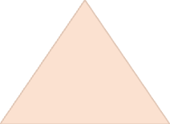







Drawer Navigator: Key Features
Custom Content
Personalize the entire drawer with drawerContent prop
Gesture Control
Adjust sensitivity and disable gestures when needed
Position Options
Place drawer on left or right side of screen
Style Customization
Control width, background, item styling
Drawer navigation offers extensive customization. You can program it to work with nested navigators, adding stack navigation within drawer screens.

Slide 19
Tab Navigation: Overview
Purpose
Common Patterns
Tab navigation provides quick switching between main app sections. It keeps primary destinations visible and accessible.
Bottom tabs (most common on iOS and Android)
Top tabs (less common, similar to browser tabs)
Material top tabs (Android style, swipeable)
Users can jump between tabs without losing their place in each section's navigation stack.
Most apps use 3-5 tabs for main sections like Home, Search, Create, Notifications, and Profile.

Slide 20
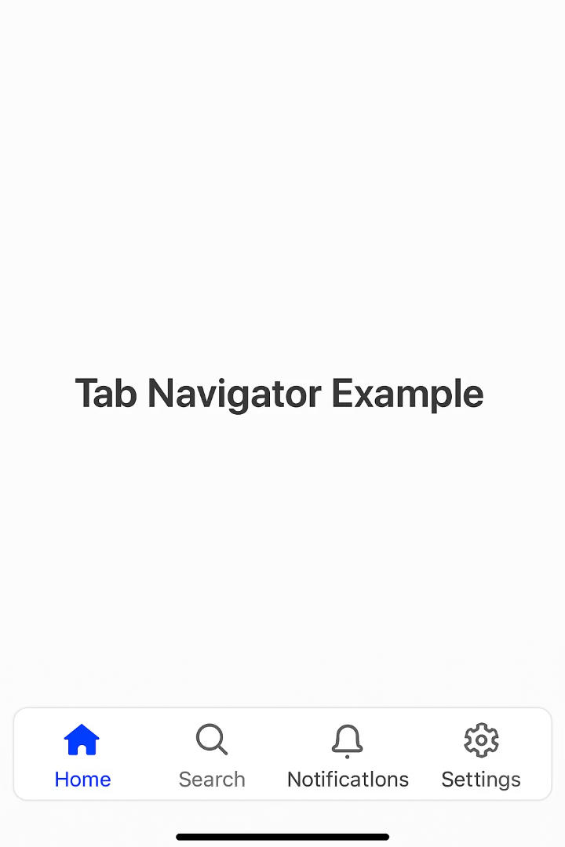
Setting Up Tab Navigation
Import Package
Import { createBottomTabNavigator } from '@react-navigation/bottom-tabs';
Create Navigator
const Tab = createBottomTabNavigator();
Set Up Tab Routes
Return Tab.Navigator with Tab.Screen components for each section
Add Icons (Optional)
Use screenOptions or options to add tab icons and styling

Slide 21
Tab Navigation: Sample Code
1. Imports and Navigator Setup
import React from 'react';
import { NavigationContainer } from '@react-navigation/native';
import { createBottomTabNavigator } from '@react-navigation/bottom-tabs';
import { View, Text, StyleSheet } from 'react-native';
import { Ionicons } from '@expo/vector-icons';
// Create the tab navigator
const Tab = createBottomTabNavigator();
2. Screen Components
const HomeScreen = () => (
<View style={styles.screen}>
<Text style={styles.title}>Home</Text>
<Text style={styles.text}>Welcome to the home screen!</Text>
</View>
);
const ProfileScreen = () => (
<View style={styles.screen}>
<Text style={styles.title}>Profile</Text>
<Text style={styles.text}>This is your profile screen</Text>
</View>
);
const SettingsScreen = () => (
<View style={styles.screen}>
<Text style={styles.title}>Settings</Text>
<Text style={styles.text}>Adjust your app settings here</Text>
</View>
);

Slide 22
Tab Navigation: Sample Code (continue)
3. Navigation Configuration
export default function App() {
return (
<NavigationContainer>
<Tab.Navigator screenOptions={({ route }) => ({
tabBarIcon: ({ focused, color, size }) => {
let iconName;
if (route.name === 'Home') {
iconName = focused ? 'home' : 'home-outline';
} else if (route.name === 'Profile') {
iconName = focused ? 'person' : 'person-outline';
} else if (route.name === 'Settings') {
iconName = focused ? 'settings' : 'settings-outline';
}
return <Ionicons name={iconName} size={size} color={color} />;
},
tabBarActiveTintColor: '#007AFF',
tabBarInactiveTintColor: 'gray',
headerShown: true,
})}>
<Tab.Screen name="Home" component={HomeScreen} />
<Tab.Screen name="Profile" component={ProfileScreen} />
<Tab.Screen name="Settings" component={SettingsScreen} />
</Tab.Navigator>
</NavigationContainer>
);
}

Slide 23
Tab Navigation: Sample Code (continue)
4. Styling
const styles = StyleSheet.create({
screen: {
flex: 1,
justifyContent: 'center',
alignItems: 'center',
padding: 16,
},
title: {
fontSize: 24,
fontWeight: 'bold',
marginBottom: 16,
},
text: {
fontSize: 16,
textAlign: 'center',
},
});

Slide 24
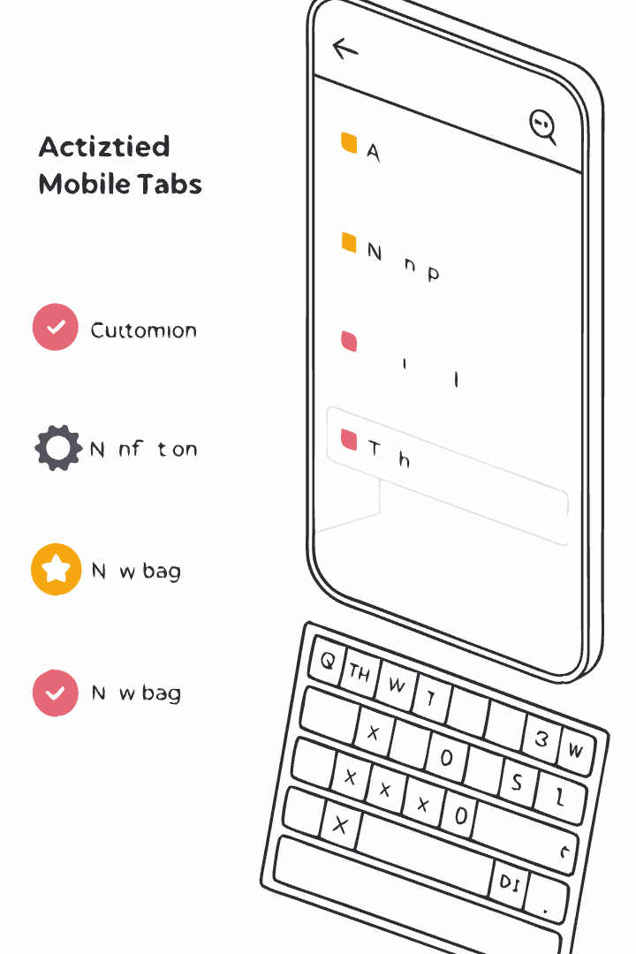




Tab Navigator: Key Features
Notification Badges
Display count indicators on tabs with tabBarBadge property. Perfect for notifications or cart items.
Appearance Customization
Control colors, icons, labels, and positioning. Adjust active and inactive states for visual feedback.
Keyboard Handling
Configure tab bar to hide when keyboard appears with tabBarHideOnKeyboard option.
Dynamic Behavior
Conditionally show/hide tabs based on state or user permissions. Helpful for restricted content.

Slide 25



Combining Navigators
Navigation Container
Root component that maintains navigation state
Primary Navigator
Usually Tab or Drawer for main app sections
Secondary Navigators
Stack navigators inside each tab/drawer screen
Nested navigation creates intuitive user experiences. A common pattern uses tabs for main sections with stack navigation within each tab for detail flows.

Slide 26
Navigation State & Props
Navigation Object
Route Object
navigation.navigate('Screen')
route.name - Current screen name
navigation.push('Screen')
route.key - Unique identifier
navigation.goBack()
route.params - Parameters object
navigation.setParams({ key: value })
Passing Parameters
// Send data
navigation.navigate('Profile', {
userId: 123,
userName: 'Jane'
});
// Access data
const { userId, userName } = route.params;

Slide 27








Best Practices & Performance
Minimize Nesting
Memoize Components
Keep navigator nesting to 3 levels or less to maintain optimal performance. Deep navigation hierarchies increase memory usage and can create confusing user experiences.
Implement React.memo() for screen components and useCallback() for navigation handlers to prevent unnecessary re-renders and improve overall application responsiveness.
Use DevTools
Lazy Loading
Regularly monitor and optimize navigation performance with React Navigation DevTools and React DevTools. These tools help identify bottlenecks and rendering issues before they impact users.
Improve initial load times by implementing dynamic imports or using the lazy option to load screens only when they're needed. This reduces bundle size and memory consumption.

Slide 28
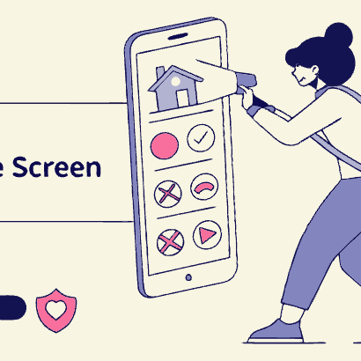
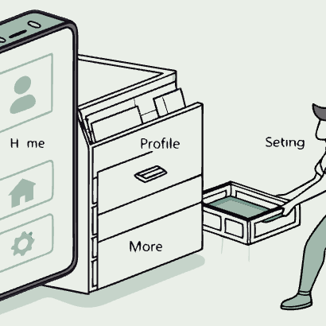
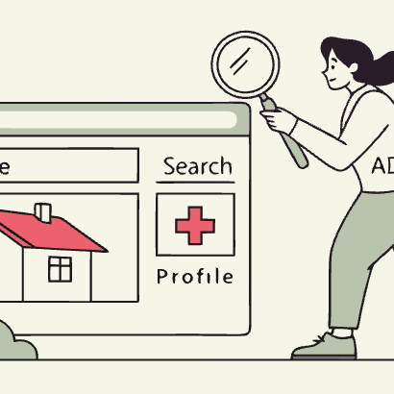
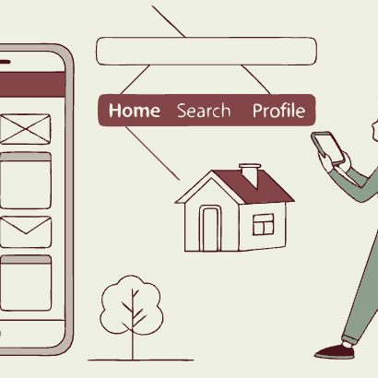
Summary & Additional Resources
We've covered Stack, Drawer, and Tab navigation patterns in React Native. Each serves specific navigation needs in your app.
For more: Visit reactnavigation.org for comprehensive docs, examples, and API references.

